Slide 1
POWER BI REPORT
NREGA ANALYSIS REPORT
By Joel George

Slide 2
NREGA ANALYSIS REPORT
CONTENTS
Introduction
Dataset Overview
Data Cleaning and Transformation
Dashboards
Insights
Conclusion

Slide 3
NREGA ANALYSIS REPORT
INTRODUCTION
The Mahatma Gandhi National Rural Employment Guarantee Act (MGNREGA), commonly known as NREGA, is a social security measure and labor law in India aimed at guaranteeing the 'right to work'. Enacted in 2005, the program’s primary objective is to enhance the livelihood security of rural households by providing at least 100 days of wage employment in a financial year to every household whose adult members volunteer to do unskilled manual work.
This project aims to analyze and visualize the National Rural Employment Guarantee Act (NREGA) dataset to extract meaningful insights. The focus is on understanding the implementation patterns, trends, and disparities across different states and districts in India. The key steps in this analysis include data preprocessing, exploratory data analysis (EDA), and data visualization to present the findings effectively. The ultimate goal is to provide actionable insights that can help policymakers and administrators optimize the NREGA program

Slide 4
NREGA ANALYSIS REPORT
DATASET OVERVIEW
The dataset consists of the following variables:
* State name: Name of the Indian state.
* district name: Name of the district within the state.
* Total No. of Job Cards issued: The total number of job cards issued to rural households.
* Total No. of Workers: The total number of workers registered under NREGA.
* Total No. of Active Job Cards: The number of active job cards at a given point in time.
* Total No. of Active Workers: The number of workers currently engaged in NREGA works.
* SC workers against active workers: The count of Scheduled Caste workers among active workers.
* ST workers against active workers: The count of Scheduled Tribe workers among active workers.
* Approved Labor Budget: The budget allocated for labor under NREGA.
* Person days of Central Liability so far: The total person days of employment provided, considering
central liability.
* SC person days: Person days of employment provided to Scheduled Caste workers.
* ST person days: Person days of employment provided to Scheduled Tribe workers.
* Women Person days: Person days of employment provided to women.
* Average days of employment provided per Household: The average number of days of employment
provided per rural household.

Slide 5
NREGA ANALYSIS REPORT
* Average Wage rate per day per person(Rs.): The average daily wage rate per NREGA worker in Indian Rupees.
* Total No of HHs completed 100 Days of Wage Employment: The number of households completing 100 days of wage employment.
* Total Households Worked: The total number of households involved in NREGA works.
* Total Individuals Worked: The total number of individuals engaged in NREGA works.
* Differently abled persons worked: The count of differently abled persons who participated in NREGA works.
* Number of GPs with NIL exp: The number of Gram Panchayats with zero expenditure.
* Total No. of Works Taken up (New + Spill Over): The total number of works initiated, including new projects and spill-over from previous periods.
* Number of Ongoing Works: The count of works that are currently in progress.
* Number of Completed Works: The count of works that have been successfully completed.
* % of NRM Expenditure(Public + Individual): The percentage of expenditure on Natural Resource Management (NRM) projects, including both public and individual contributions.
* % of Category B Works: The percentage of expenditure on Category B works.
* % of Expenditure on Agriculture & Agriculture Allied Works: The percentage of expenditure on agriculture and allied activities.
* Total Exp(Rs. in Lakhs.): Total expenditure in Indian Rupees (in lakhs).
* Wages(Rs. In Lakhs): Expenditure on wages in Indian Rupees (in lakhs).
* Material and skilled Wages(Rs. In Lakhs): Expenditure on materials and skilled wages in Indian Rupees (in lakhs).
* Total Adm Expenditure (Rs. in Lakhs): Total administrative expenditure in Indian Rupees (in lakhs).

Slide 6
NREGA ANALYSIS REPORT
DATA CLEANING AND TRANSFORMATION
There was no need of data cleaning and transformation as the data was already calculated and was in a good shape with no NULL values, duplicate or inaccurate values.

Slide 7
NREGA ANALYSIS REPORT
DASHBOARDS

Slide 8
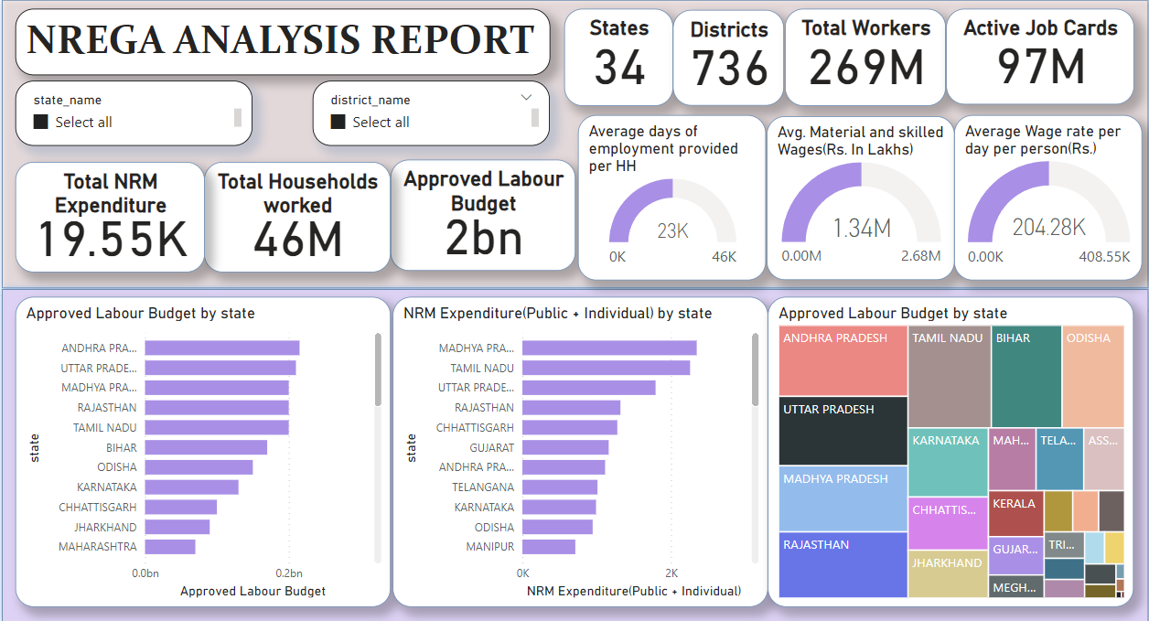

Slide 9
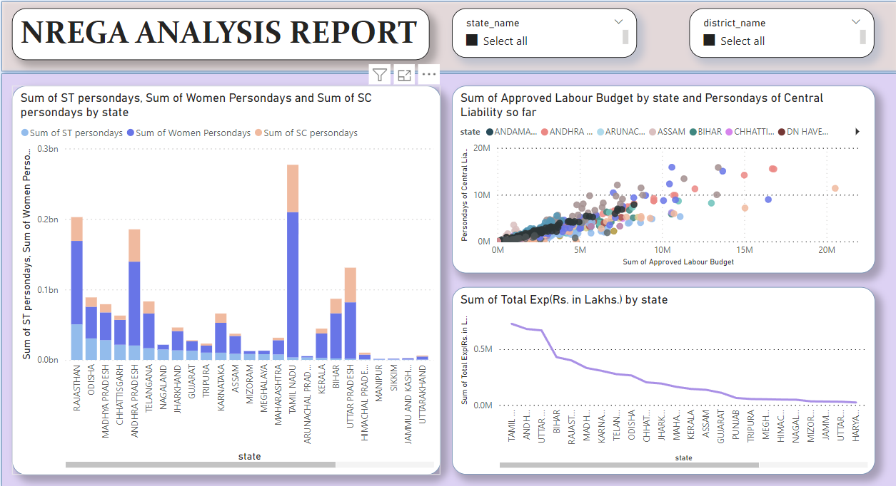

Slide 10
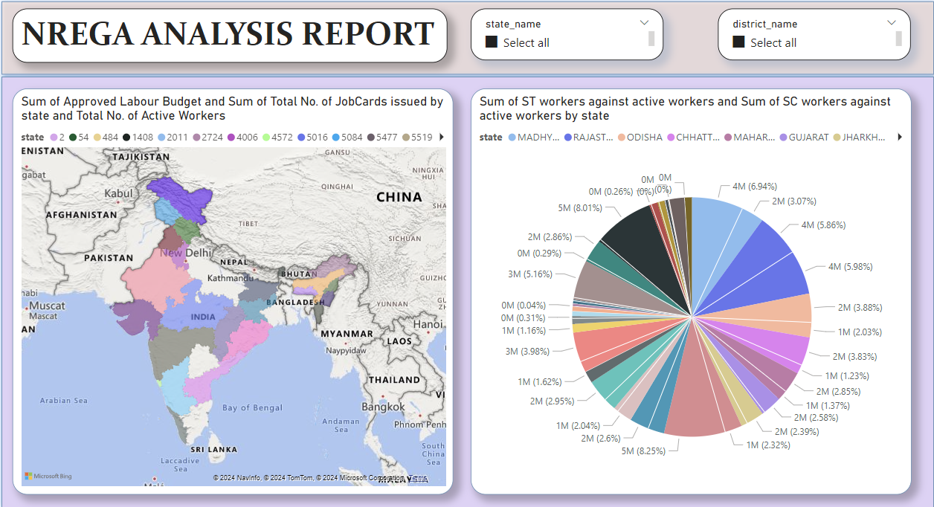

Slide 11
States like Tamil Nadu might show a higher proportion of women workers, reflecting gender inclusivity.
NREGA ANALYSIS REPORT
KEY INSIGHTS
In the stacked bar chart 1 we can see that the approved labour budget by state are shown. From the graph it is clear that Andhra Pradesh have the most approved labour budget (215 M) and West Bengal have 0 approved labour budget.
In the stacked column chart in second page we analyzed the participation of SC, ST, and women workers to assess inclusivity in employment. From this, States like Tamil Nadu show a higher proportion of women workers, reflecting gender inclusivity.
In the same page we found the Correlation to the approved labor budget with the number of persondays generated to understand the effectiveness of budget utilization using scatter plot. From this we come to know that states with higher labor budgets ideally have higher persondays generated.
In the same page we also created a line graph of total expenditure to the state where we see that Tamil Nadu have the highest total expenditure .
In the third page we created a filled map to analyze the distribution of job cards, active workers, and budget utilization across different states. Here we see that certain northeastern states show lower numbers of job cards and budget utilization, highlighting potential areas for policy intervention.
In the same page we created a pie chart showing the sum of SC and ST workers in state which shows us that Rajasthan has the highest SC and ST workers in the country.

Slide 12
States like Tamil Nadu might show a higher proportion of women workers, reflecting gender inclusivity.
NREGA ANALYSIS REPORT
ACTIONABLE INSIGHTS
Increase Budget Allocation in Underfunded States: Conduct a detailed review of the budget allocation process for West Bengal and ensure appropriate funding to support employment generation activities. Consider reallocating unused funds from other states or increasing overall budgetary provisions.
Promote Gender Inclusivity in Employment Programs: Implement targeted initiatives in other states to encourage the participation of women in NREGA activities. This could include awareness campaigns, safety measures for women at worksites, and incentives for contractors who hire more women workers.
Ensure Effective Utilization of Labor Budgets: Regularly monitor and audit the relationship between budget allocation and persondays generated. Provide training and resources to states with lower budget utilization to enhance their capacity to execute NREGA projects efficiently.
Analyze High Expenditure in Tamil Nadu for Best Practices: Conduct a detailed analysis of Tamil Nadu’s expenditure patterns and project implementation strategies. Identify best practices and successful initiatives that can be replicated in other states to improve their performance and expenditure efficiency.
Targeted Interventions for Northeastern States: Develop and implement specific policies aimed at increasing participation in NREGA in northeastern states. This could include localized training programs, improved infrastructure for project implementation, and focused community engagement activities.

Slide 13
States like Tamil Nadu might show a higher proportion of women workers, reflecting gender inclusivity.
NREGA ANALYSIS REPORT
CONCLUSION
The NREGA program shows considerable variability in its implementation across different states and districts, with notable disparities in fund allocation, workday distribution, and worker participation. By addressing these issues through targeted policies and interventions, the program can become more effective and equitable ensuring that it meets its goal of providing employment and enhancing rural livelihoods. This analysis provides a foundation for informed decision-making and strategic planning to improve the NREGA program's impact across India.

Slide 14
States like Tamil Nadu might show a higher proportion of women workers, reflecting gender inclusivity.
NREGA ANALYSIS REPORT
THANK YOU….

